Slide 1
Using Object-Oriented Programming
Fighting Fantasy Battles - Characters

Slide 2
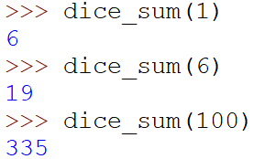

Starter – dice-rolling function
Write a function that simulates the rolling of n dice and adding the score
(Extension) can you adapt your program so the user can also (optionally) input the number of sides for each dice (default = 6).
Output

Slide 3
Dice-rolling function
import random def dice_sum(num_dice: int = 1, num_sides: int =6): """returns the sum of num_dice dice, each with num_sides sides""" total = 0 for _ in range(num_dice): dice_roll = random.randint(1, num_sides) total += dice_roll return total
def dice_sum(num_dice: int = 1, num_sides: int =6): """returns the sum of num_dice dice, each with num_sides sides""" return sum(random.randint(1, num_sides) for _ in range(num_dice))

Slide 4
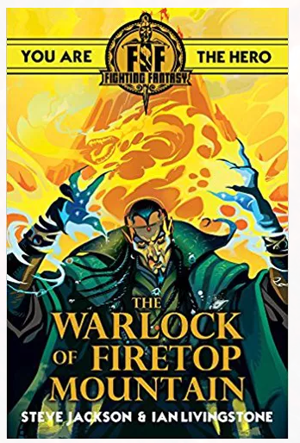
Fighting Fantasy
The fighting fantasy game books had a simple fighting system
You and your opponent have a SKILL score
Each character rolls two dice and adds it to their SKILL score
The loser loses two from their stamina
If there is a draw each character losses one from their stamina
E.g.
A hero, SKILL 10, STAMINA 12 vs
An ogre, SKILL 9, STAMINA 8

Slide 5
Breaking down the problem
To re-create Fighting Fantasy battles in Python
What objects could be used to represent the game?
What attributes would be used to represent instances of the objects?
How would you control the interactions between the user and the objects?

Slide 6
Represent a Character
A Character object needs to have:
name
skill
stamina
Write a template for the Character object
write an __init__ function to create instances of Character with these attributes
write a __repr__ function that will return a string reprenting the character, e.g. Character('Dragon', skill=10, stamina=22)

Slide 7
Represent a Character
class Character: """ A Fighting Fantasy Character Object""" def __init__(self, name, skill=0, stamina=0): self.name = name self.skill = skill self.stamina = stamina def __repr__(self): return f"Character('{self.name}', skill={self.skill}, stamina={self.stamina})"

Slide 8
Create and code roll and score
In order to fight a character will need to create a roll by rolling two dice and a score by adding the roll to the characters skill.
Add .roll and .score as attributes with initial value None
Write a method that will throw two dice and set the .roll and .score attributes
def find_score(self):

Slide 9
Create and code roll and score
class Character: """ A Fighting Fantasy Character Object""" def __init__(self, name, skill=0, stamina=0): self.name = name self.skill = skill self.stamina = stamina self.roll = None self.score = None def find_score(self): self.roll = dice_sum(num_dice=2) self.score = self.roll + self.skill

Slide 10
Getting wounded
A character can be wounded in a fight.
Create a method .take_hit that will reduce a character’s stamina by damage.
The default damage is 2 but this can be overwritten
>>> pc
Character('Sir Andrew', skill=7, stamina=20)
>>> pc.take_hit()
>>> pc
Character('Sir Andrew', skill=7, stamina=18)
>>> pc.take_hit(1)
>>> pc
Character('Sir Andrew', skill=7, stamina=17)

Slide 11
Getting wounded
class Character: """ A Fighting Fantasy Character Object""" ... def take_hit(self, damage = 2): self.stamina -= damage

Slide 12
Fight a round
We’re now ready to fight a round. Write a method .fight_round
The arguments will be self and other, where other represents another character.
Find the score for each character
The loser should be wounded
In the case of a draw, each character should be wounded 1 Stamina
Keep track of the result by returning ‘won’, ‘lost’ or ‘draw’ from the method

Slide 13
Fight a round
class Character: """ A Fighting Fantasy Character Object""" ... def fight_round(self, other): self.find_score() other.find_score() if self.score > other.score: result = 'won' other.take_hit() elif self.score < other.score: result = 'lost' self.take_hit() else: result = 'draw' self.take_hit(1) other.take_hit(1) return result
>>> pc
Character('Sir Andrew', skill=7, stamina=17)
>>> orc = Character('Orc', skill=6, stamina=12)
>>> pc.fight_round(orc)
'lost'
>>> pc
Character('Sir Andrew', skill=7, stamina=15)
>>> orc
Character('Orc', skill=6, stamina=12)

Slide 14
Is a character dead?
A character is dead if their stamina is less than zero
Write a method to determine if a character is dead
Use the @property decorator to make the method a property

Slide 15
Is a character dead?
@property def is_dead(self): # character.is_dead will now return True or False return self.stamina <= 0 @is_dead.setter def is_dead(self, dead: bool): # character can be made dead or alive by setting is_dead to True or False if dead: self.stamina = 0 else: self.stamina = min(self.stamina, 1)

Slide 16
Generate a PlayerCharacter
In Fighting Fantasy there is usually a PlayerCharacter (PC) who interacts with NonPlayerCharacters (NPC)
The PlayerCharacter has all the attributes and methods of the Character object, but will have some additional properties.
In OOP, we can create a PlayerCharacter sub-class of Character
PlayerCharacter inherits the attributes and methods of its super-class
We can write new or existing attributes and methods to overwrite the properties of the super-class

Slide 17
The PlayerCharacter subclass
The PlayerCharacter subclass will have the additional attribute luck
We will also write a new classmethod that can be used to generate a new character with:
skill = 6 + 1D6
stamina = 12 + 2D6
luck = 6 + 1D6
If, like me you don’t know what 2D6 means then do some research!
class PlayerCharacter(Character): def __init__(self, name, skill=0, stamina=0, luck=0): super().__init__(name, skill, stamina) self.luck = luck @classmethod def generate_player_character(cls, name): # Roll for skill stamina and luck and pass them to the
cls constructor, returning the created instance … return cls(name, skill, stamina, luck)

